Slide 1
Testing & Quality Assurance
Sales slides

Slide 2
Testing & Quality Assurance
Sales slides
Testing & Quality Assurance in Vincit way
Benefits of testing
Testing services
Testing capabilities
Test automation
Testing levels
Quality criteria & KPIs
Test tools
Performance testing
Security testing
Accessibility testing

Slide 3
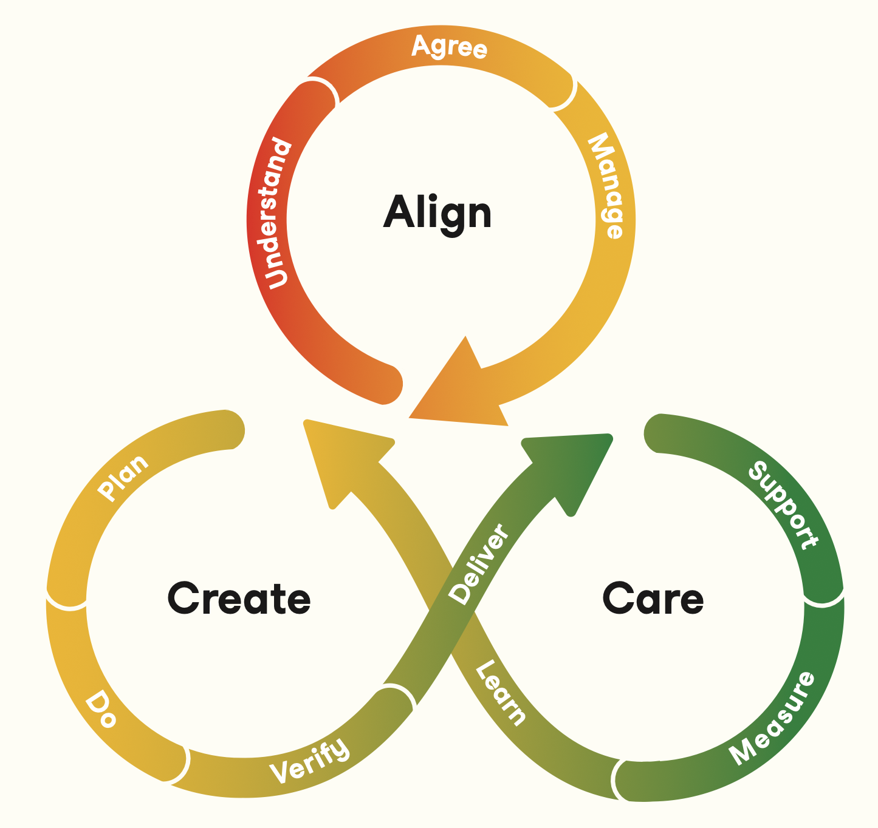
TESTING & QA THE VINCIT WAY
Test Planning: Analyze customer needs to identify risks and important quality requirements, and create plans to meet these needs.
Ways of working: Agree on quality assurance and testing processes together with the team and the customer.
Test Reporting: Communicate test results and information about the quality of the product or service.
ALIGN
Testing and quality assurance is built in everything we do. We ensure quality of our software deliveries by working with the customer to understand the needs, using quick feedback cycles, peer reviews, and more.
Steering group
CREATE
CARE
Test Execution: Test the design and implementation, and identify defects. Carry out exploratory testing to identify potential issues In the usability, accessibility, and performance.
Test Automation: Automate test cases to validate key functionality works as intended and previously fixed issues do not resurface.
CI / CD: Setup and maintain continuous testing environments for integration and deployment.
Sprint planning
Sprint reviews
Monitoring: identify development needs from user feedback and respond to incidents.
Issue Tracking: Report, track and manage identified issues, ensuring they are addressed and resolved.
User Acceptance Testing: Support customer with acceptance testing practices and learn from feedback.
Retrospectives

Slide 4
OUR APPROACH TO TESTING & QA
ALIGN
CREATE
CARE
Test Planning: Analyze customer needs to identify risks and important quality requirements, and create plans to meet these needs.
Ways of working: Agree on quality assurance and testing processes together with the team and the customer.
Test Reporting: Communicate test results and information about the quality of the product or service.
Test Execution: Test the design and implementation, and identify defects. Carry out exploratory testing to identify potential issues In the usability, accessibility, and performance.
Test Automation: Automate test cases to validate key functionality works as intended and previously fixed issues do not resurface.
CI / CD: Setup and maintain continuous testing environments for integration and deployment.
Monitoring: identify development needs from user feedback and respond to incidents.
Issue Tracking: Report, track and manage identified issues, ensuring they are addressed and resolved.
User Acceptance Testing: Support customer with acceptance testing practices and learn from feedback.

Slide 5




BENEFITS OF TESTING
Improved Product Quality
Testing helps identify and fix bugs early, ensuring a high-quality product. Both functional and non-functional quality characteristics are taken into account when testing the product.
Better User Experience
Testing involvement improves understanding of the customer requirements, ensuring that we are building the right product, and leading to improved user experience and better adoption of new services.
Cost Savings
Early identification and resolution of issues reduce the cost of fixing problems in later stages. Less investment needed in the customer's own verification work and customer service.
Reliability
Continuous testing and quality assurance ensures that software releases are stable and usable. Test automation speeds up the development process and reduces repetitive work and regression.

Slide 6



TESTING SERVICES
Basic delivery
Improved testing services
Advanced testing services
Unit testing
Integration testing:
  Backend
  Frontend
Static code analysis and security checks
CI test automation
System integration testing
Exploratory testing
System test automation
Deployment test automation
User acceptance test planning & facilitation with the customer
Bug management
Test management
Security testing (OWASP, penetration testing)
Performance testing (load testing, web performance)
Consultation for customer’s testing processes & strategy
End user testing
Accessibility testing & audits

Slide 7




TESTING AND QUALITY ASSURANCE CAPABILITIES
AGILE TESTING
TEST MANAGEMENT
& COACHING
TEST AUTOMATION
& DEVOPS
We consider quality assurance and testing throughout the development lifecycle from planning to production. Testing early provides fast feedback to the development and customer.
We can help our customers in their quality assurance & testing processes and strategy. We can manage testing activities and resources and coordinate testing work. We can facilitate User Acceptance Testing.
Test automation is in the core of modern software development. Automating just the right amount of tests at the right level ensures that the system continuous to work as planned.
END-TO-END & EXPLORATORY TESTING
USABILITY & ACCESSIBILITY
PERFORMANCE & SECURITY TESTING
We do end-to-end testing to verify user stories and the full chain system functionality. Testing can be done against requirements and acceptance criteria, but also by exploring the system.
We take usability and accessibility into account from the very beginning of software development and design. We can do end user testing sessions and accessibility testing & audits.
We take into account the requirements for the performance and security of the system, and plan testing accordingly. We put focus on the most important aspects of the software delivery.

Slide 8
AI-ASSISTED TESTING & QUALITY ASSURANCE
Generative AI & Test Creation
Intelligent Analysis & Prediction
Visual & User Experience Testing
Code Assistance & Self-Healing Scripts
Automated Test Generation:
AI can analyze user stories, application requirements, and even user behavior data to automatically generate comprehensive test cases.
Natural Language Test Creation:
Some platforms allow testers to describe a test scenario in plain English, and AI automatically translates it into an executable test script.
Benefits:
Improve efficiency & test coverage
Focus on end-user perspective
Example Tools:
Atlassian Rovo, LambdaTest KaneAI, TestRigor
Risk-Based Test Prioritization:
By analyzing various factors like code complexity, code change frequency, and impact on critical user flows, AI helps identify high risk areas and prioritize which tests to run.
User Feedback Analysis:
AI-powered tools can process large volumes of user feedback from app stores, support tickets, and social media to identify common issues and emerging bugs.
Benefits:
Prioritize testing efforts on high-risk areas
Faster feedback & bug prevention
Example Tools:
Sauce Labs, Sealights, BrowserStack
Visual Regression Testing: AI-powered tools compare screenshots of an application's UI before and after a change to detect subtle visual discrepancies, such as layout shifts, font changes, or broken elements.
Accessibility Testing:
AI can analyze an application's UI to identify potential accessibility issues for users with disabilities, such as color contrast problems or missing alt text on images.
Benefits:
Identify issues that are difficult for traditional tools to find
Example Tools:
Applitools, TestComplete, Perfecto
Code Assistants:
AI tools help writing and debugging test code, generating test boilerplate, and suggesting test-related functions.
Self-Healing Scripts:
AI can automatically detect and adapt to changes in application’s UI, such as changed element locators or a rearranged layout and update automated tests.
Benefits:
Improve efficiency & reliability
Example Tools:
GitHub Copilot, Mabl, Testim, Accelq

Slide 9
TEST AUTOMATION
Benefits
What to automate
Not to automate
Reduce repetitive work
Speed up development
Find bugs earlier
Improve reliability (reduce human error)
Improve test coverage
Regression tests
Data intensive tests
Low level tests (unit tests)
Performance tests
Tests that take long time
Boundary values, exceptions
Multiple configurations
Critical end-to-end flows
Exploratory testing
User acceptance testing
Usability testing
Visual testing
Tests without predictable results
Maintenance of the automated tests

Slide 10
TEST LEVELS
Testing and quality assurance should be done on many levels.
Typically lower level tests are smaller and faster to execute, where as upper level tests may take more time and focus on complete user paths.
Tests can be partially or fully automated in all levels.
Production tests & monitoring
Monitor system health and detect issues in real-time
Acceptance tests
Evaluate the service against business requirements
End-to-end testing of the entire system against specifications
System tests
Integration tests
Testing interactions between integrated modules or components
Unit tests
Validate low level implementation and provide fast feedback
Inspect code to identify defects or adherence to coding standards
Static code analysis

Slide 11
TEST AUTOMATION TYPES
Test automation can be done on many levels of the software stack. Unit tests verify small isolated parts of the code, integration tests verify the interactions between components, and System / E2E tests verify the whole system.
Unit tests
Integration tests
System tests / E2E tests
Frontend
Frontend
Frontend
Frontend
Frontend
Presentation
Domain
Infrastructure
Integrations
Backend
Backend
Backend
Backend
Backend
API
Service
Interfaces
Databases
Databases
Databases
Databases
Databases

Slide 12
Testing capabilities & roles
Testing capabilities
Agile testing
Test manager
Usability &
Accessibility
Test management
Test specialist
Test lead
Security &
Performance
Quality coaching
Quality coach
Test architect
Platforms
Test automation
CI / CD
DevOps engineer
Test automation specialist

Slide 13
Quality criteria & KPIs
Quality criteria and KPIs agreed in the project guide test planning and execution and they are evaluated continuously.
Examples of Quality criteria:
Examples of Testing KPIs:
Bugs found in development vs. production
Cycle time for bug fixes
Test coverage on code or feature level
DevOps metrics measure the performance & quality of the entire development team, including testing:
Lead time for changes
Change failure rate
Deployment frequency
Mean time to recovery
Accessibility
Usability
Security
Performance
Reliability
Compatibility
Maintainability
Testability

Slide 14


























TEST TOOLS
Usage of test tools are planned based on customer and project needs and used technology stack.
Test management
Test automation
DevOps
TODO: Mobile testing tools & platforms

Slide 15
Performance testing

Slide 16
SECURITY TESTING
Threat Modeling
Risk Assessment
Security Requirements
Compliance Requirements
Change Management
Security Approvals
As all testing, security testing should be built in all phases of the software delivery.
ALIGN
CREATE
Steering group
Secure Coding Practices & Code Review Guidelines
Automated Security Testing:
  Static Application Security Testing (SAST)
  Dynamic Application Security Testing (DAST)
  Software Composition Analysis (SCA)
  Interactive Application Security Testing (IAST)
Security Testing:
  Authentication and Authorization
  Data protection
  Input validation
  Error handling
  Penetration Testing
CARE
Sprint planning
Sprint reviews
Secure Deployment Practices
Production Logging
Security Monitoring
Patch Management
Backup and Disaster Recovery
Vulnerability Scanning
Security Audits
Incident Response
Retrospectives

Slide 17
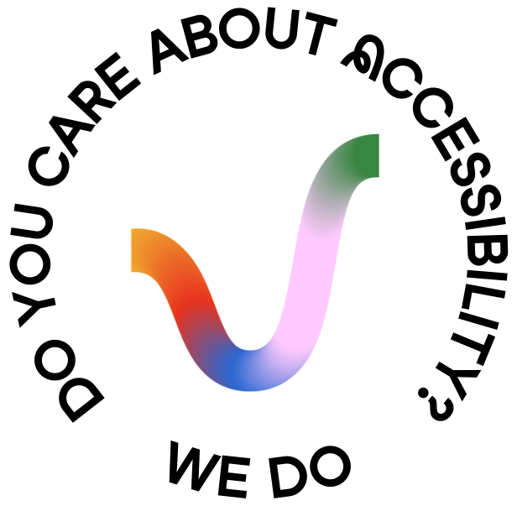
ACCESSIBILITY TESTING
Accessibility sales deck:
https://docs.google.com/presentation/d/1hjBrRHvPZoZ0BX8Zz1B8qoflAgZKKTpOwqNUvv-Ohkg/edit?usp=sharing

Slide 18
Backup materials

Slide 19























VINCIT DEVOPS SOFTWARE DELIVERY MODEL
Project management
Concepting and design
Packaging:
Agile backlog management tools are integrated with the whole delivery pipeline to give full visibility in development.
User-interface, layout and theme is reviewed and iterated using modern interactive quick-prototyping tools.
Build artifacts are packaged as container images to guarantee immutable and documented runtime environments with known external configuration.
Documentation:
Infrastructure automation
Setting the key values, principles and ways of working. Creating long term organisational change and better employee experience.
All cloud infrastructure components are provisioned using code-based tools to guarantee known configuration and avoid operator errors.
Feature implementation:
We bring our best DevOps practices and automated tools to the project, as applicable, including e.g. source code management and code peer review tools.
Releasing
New deliverables are continuously released to staging environment using fully automated continuous delivery pipeline. All environments including production are deployed based on the source code branch or one-click approval. All progress is instantly visible for customer acceptance testing or pilot user groups with early access to releases. Deployments are automatically rolled back on failure.
Build and dependencies
Well-defined open-source dependency versions can be used to check libraries and framework against public vulnerability databases.
Automated testing
Deployment
Limited (not 100% coverage of use cases) manual testing end-to-end testing via user interfaces is performed for sprint demos and releases.
By default we build systems to which new features can be deployed without interruption to use of existing services and manual labor needed.
Continuous Integration
End-user analytics
System monitoring
Each code increment is automatically verified by running automated tests, test coverage reported, checked for vulnerabilities, compared to common code style guides.
Web and mobile analytics software is used to capture user behaviour, collect detailed error feedback and identify pain-points by screen capture.
Availability and response times are continuously monitored using health check endpoints. Diagnostic agents, exception and log monitoring software can be used to trigger pager alerts.

Slide 20
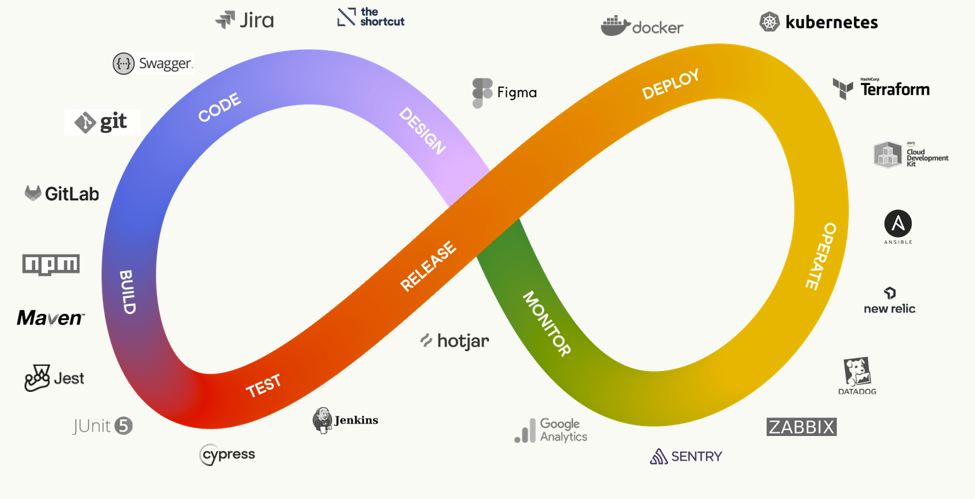
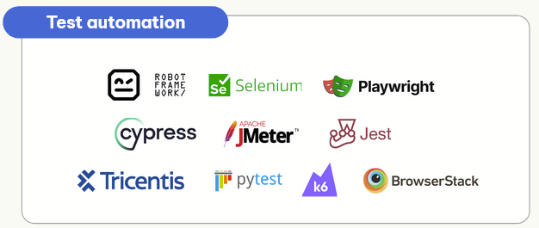
VINCIT TESTING & QUALITY ASSURANCE 1 PAGER DRAFT
VINCIT DEVOPS SOFTWARE DELIVERY MODEL
TESTING & QUALITY ASSURANCE CONSULTING
BENEFITS OF TESTING & QUALITY ASSURANCE
Test strategy
Test management
Test automation
Test execution
DevOps & CI/CD
End user testing
User acceptance testing
Accessibility testing & audits
Quality coaching
Improved Product Quality: Testing helps identify and fix bugs early, ensuring a high-quality product. Both functional and non-functional quality characteristics are taken into account in all phases of development.
Better User Experience: Testing involvement improves understanding of customer requirements, leading to a seamless user experience and better adoption of new services. Requirement specification with test planning facilitates the customer's User Acceptance Testing (UAT).
Cost Savings: Early identification and resolution of issues reduce the cost of fixing problems in later stages. Less investment needed in the customer's own verification work and customer service.
Confidence: Continuous testing and quality assurance ensures that software releases are stable and bug-free. Test automation speeds up the development process reducing repetitive work and regression.
Holistic testing in all phases of the delivery:
Test planning and design for testability
Ways of working supporting quality assurance
Testing the design and prototypes
Test automation and CI/CD development
Test environment & deployment setup
Acceptance testing with the customer
Usability and accessibility testing
Performance & security testing
Issue tracking & resolution
TEST (AUTOMATION) LEVELS
Production tests & monitoring
QUALITY CHARACTERISTICS
Acceptance tests
System tests
TESTING TOOLS
Accessibility
Usability
Integration tests
Security
Performance
Reliability
Unit tests
Compatibility
Maintainability
Static code analysis
Testability

